Slide 1
قائمة الاقتناءات الجديدة لقسم اللغة الانجليزية لسنة2023

Slide 2
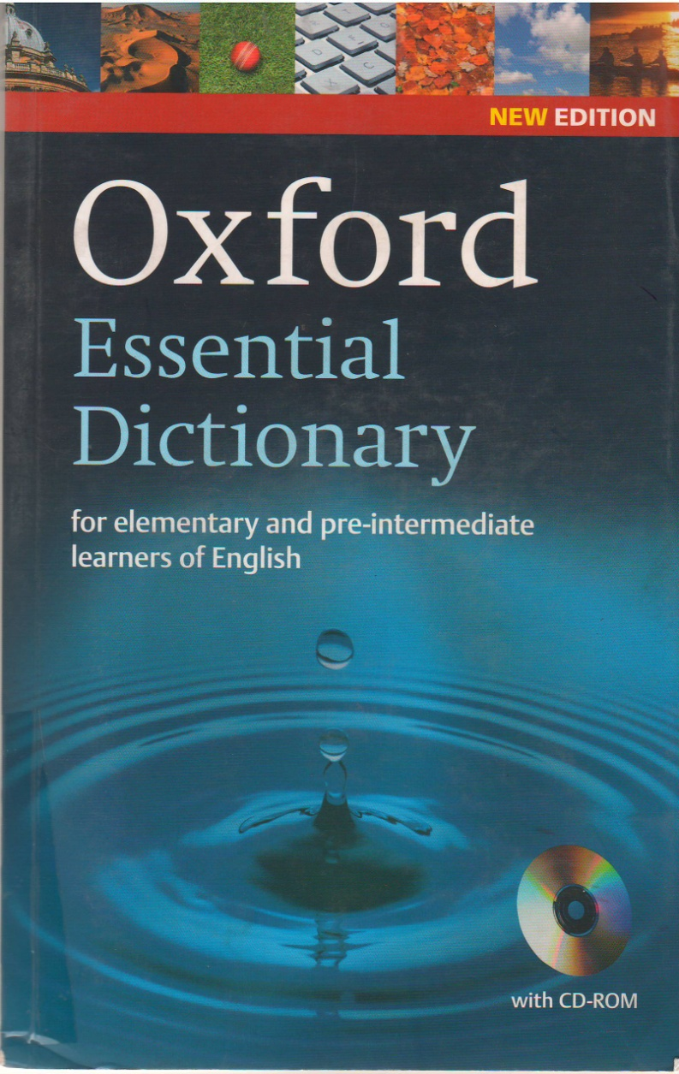
.
.
Detailed information
Oxford
Oxford essential dictionary : for elementary and pre-intermediate learners of english / Oxford. - Oxford :
Oxford University Press, 2006. - VIII-4896 p. : ill. en coul. + un cédérom ; 20 cm.
ISBN 978-0-19-433403-7
English (dictionaries); English (language) – Dictionaries
OXF/81’374

Slide 3
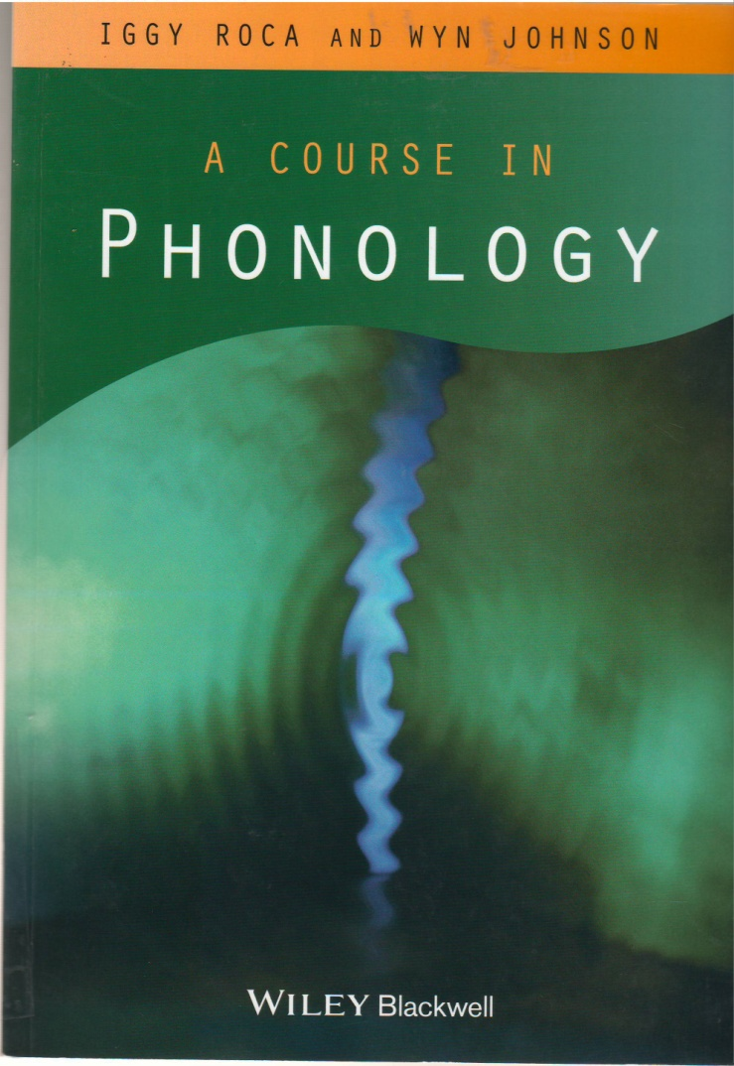
Detailed information
Roca, Iggy M.
A course in phonology / Iggy M. Roca, Wyn Johnson. - Oxford; Malden : Blackwell Publishers, 1999. -XXI-725 p. ; 26 cm.
Bibliogr. p. 665-682. Index
ISBN 978-0-631-21346-8
English language - phonology; Grammar, Comparative and general - Phonology; Phonostylistics; Phonology
ROC/81’34

Slide 4
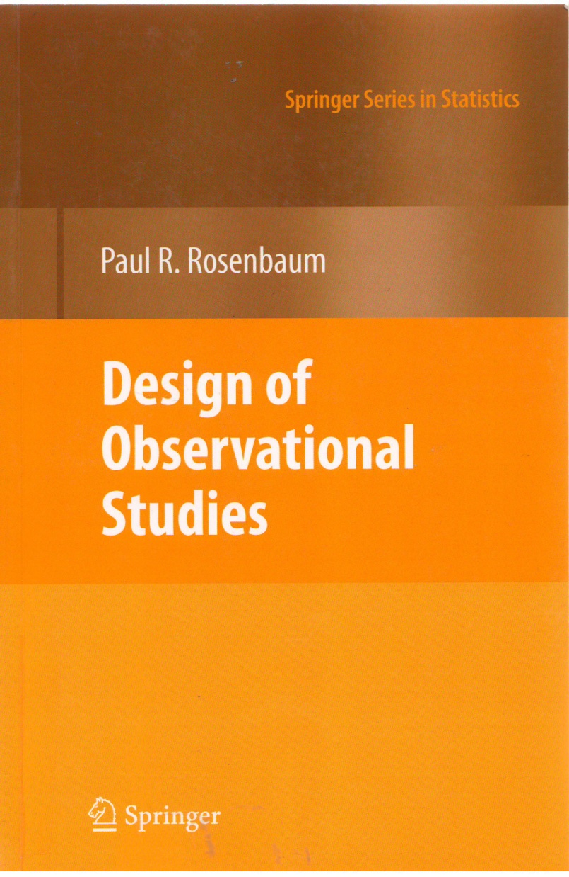
Detailed information
Rosenbaum, Paul R.
Design of bservational studies / Paul R. Rosenbaum. - New York : Springer New York, 2010. - 384p. : couv.en coul. ; 24 cm. - ((Springer series in statistics)).
Statistical methods; Psychological tests and testing; Econometrics; Social sciences – Methodology;Biostatistics; Psychology-Methodology; Probabilities
ISBN 978-1-4419-1213-8
ROS/001

Slide 5
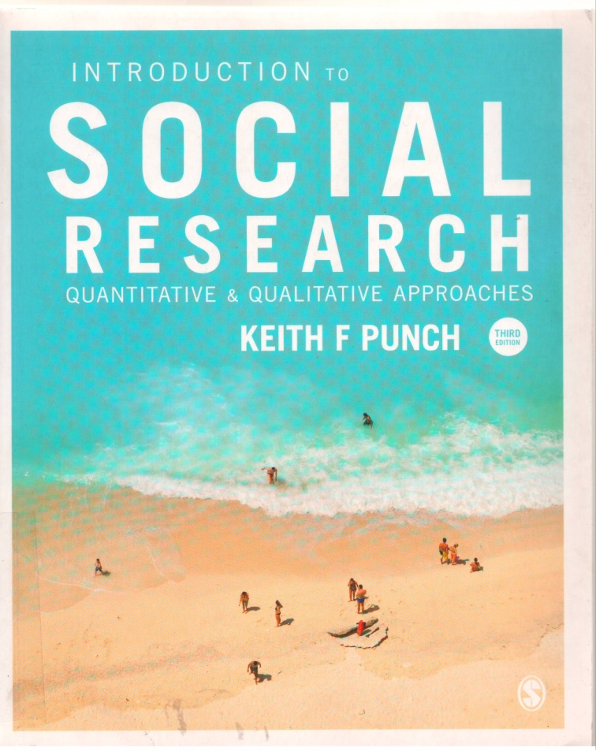
Detailed information
Punch, Keith
Introduction to social research : quantitative and qualitative approaches / Keith Punch. - Ed.03. - Los Angeles;London; New Delhi [etc] : Sage, 2014. - XVI-386 p. ; 24 cm.
Bibliogr. p. 359-375. Glossaire. Index
ISBN 978-1-446-24093-9
Social sciences - research
PUN/001

Slide 6
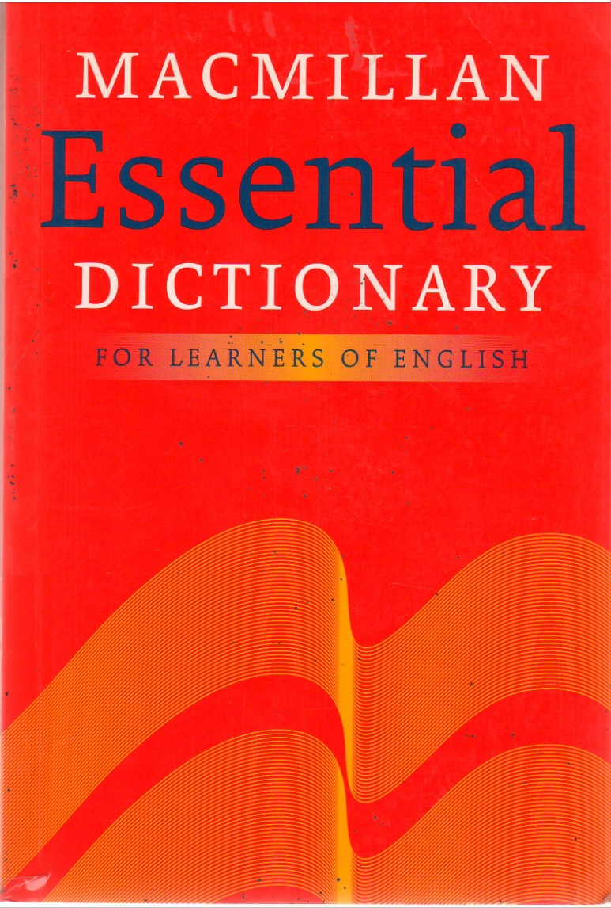
Detailed information
Macmillan education.
Macmillan essential dictionary for learners of English / Macmillan education.. - Oxford : Macmillan, 2007. - 861p. : ill. ; 20 cm.
iSBN 978-0230-03948-3
English language - ictionaries; English (dictionaries )
MAE/81’374

Slide 7
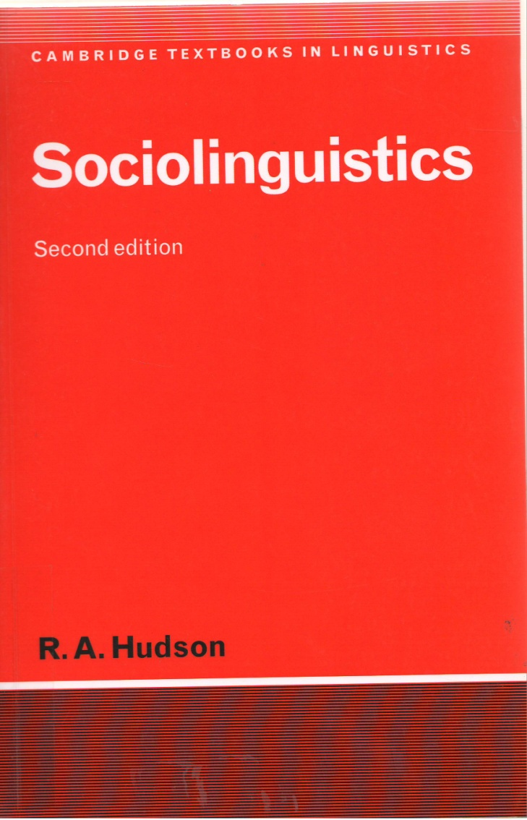
Detailed information
Hudson, Richard Anthony
Sociolinguistics / Richard Anthony Hudson. - New York; Cambridge; Melbourne : Cambridge University Press,
1996. - xv-279 p. : ill. ; 23 cm. - (Cambridge textbooks in linguistics).
ISBN 0-521-56514-6
Sociolinguistic
HUD/81’27

Slide 8
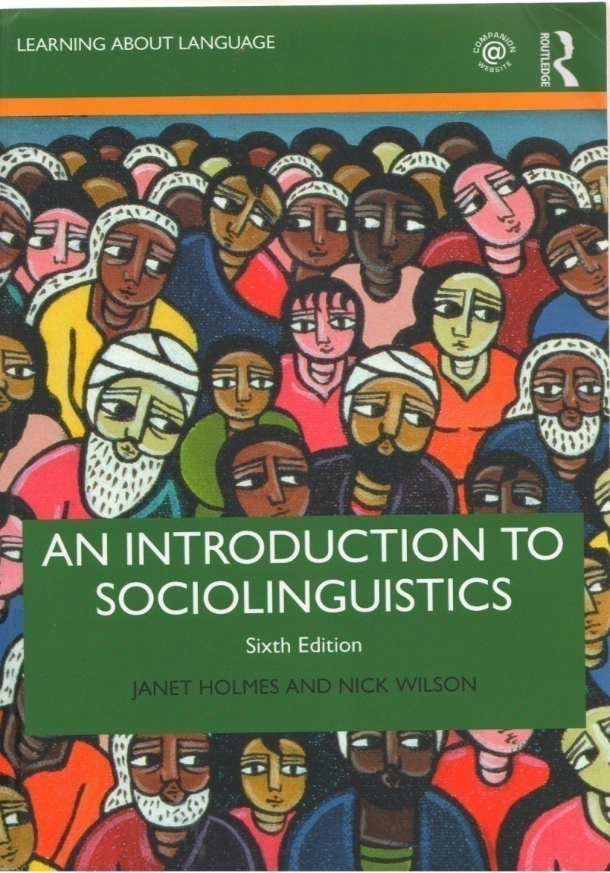
Detailed information
Holmes, Janet
An introduction to sociolinguistics / Janet Holmes, Nick Wilson. - Ed. 05. - London; New York : utledge,
2017. - XXI-538 p. : couv. ill. en coul. ; 26 cm. - ((Learning about language)).
Bibliographie p. 477- 498
English(language) - variation; multilingual
HOL/81’27

Slide 9
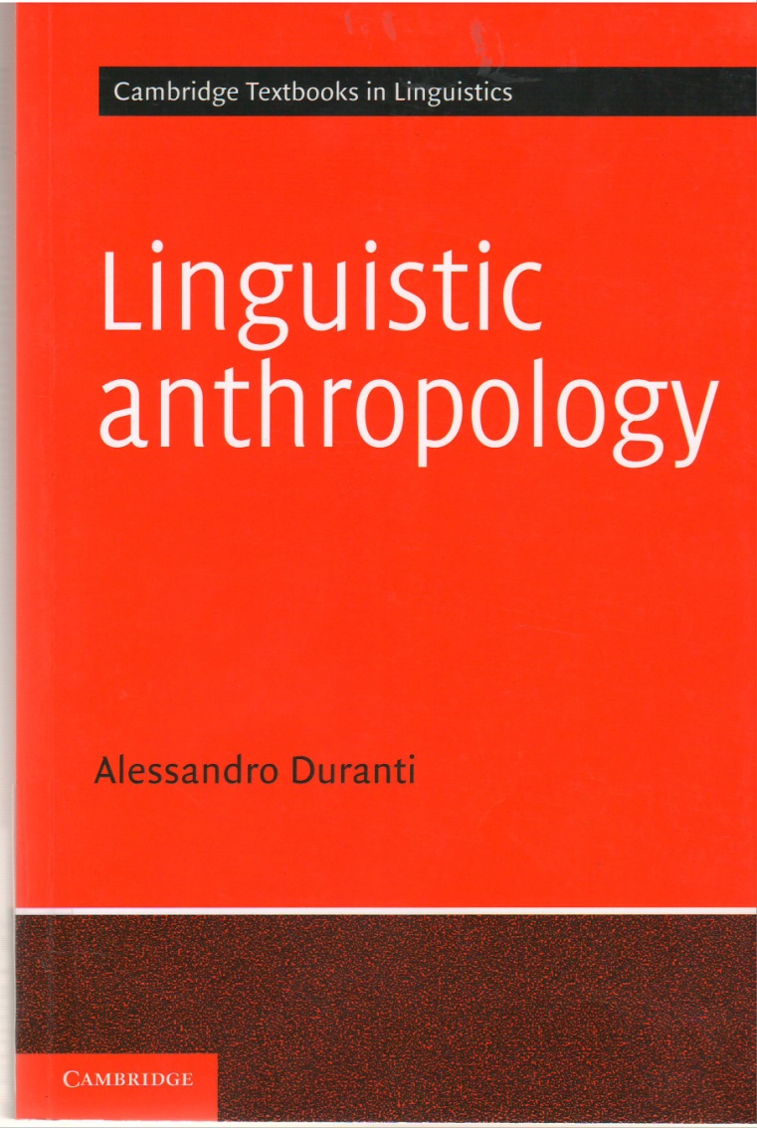
Detailed information
. Duranti, Alessandro
Linguistic anthropology / Alessandro Duranti. - New York : Cambridge University Press, 1997. - XXI-398 p. :ill. en noir ; 23 cm. - (Cambridge textbooks in linguistics.).
Bibliogr. p. 348-386. Notes
ISBN 978-0-521-44993-9
DUR/81’27

Slide 10
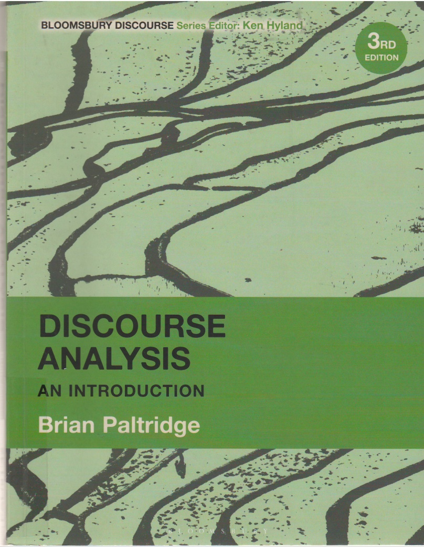
Detailed information
Paltridge, Brian
Discourse analysis : an introduction / Brian Paltridge. - Ed.03. - London; New York; Oxford [etc] : Bloomsbury
Academic, 2022. - VIII-315 p. : ill., couv. ill. ; 25 cm. - (Bloomsbury discourse series
Bibliogr. p. 273-304. Index
ISBN 978-1-350-09362-1
PAL/81’42

Slide 11
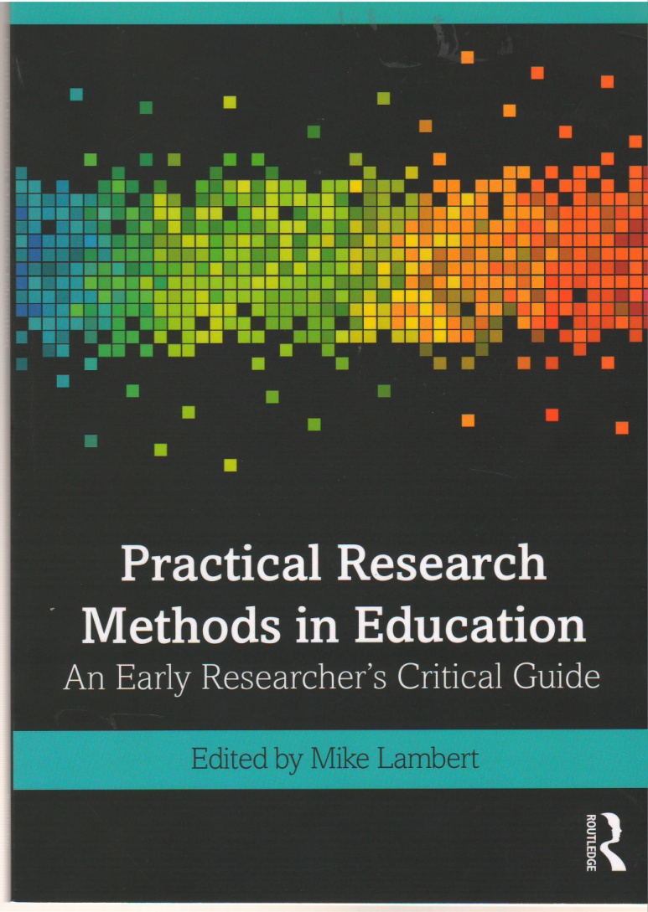
Detailed information
Lambert, Mike
Practical Research Methods in Education : An Early Researcher's Critical Guide / Mike Lambert. - London :
Routledge, 2019. - 153 p. : couv.ill. en coul. ; 24 cm.
ISBN 978-0-8153-9356-6
LAM/001

Slide 12
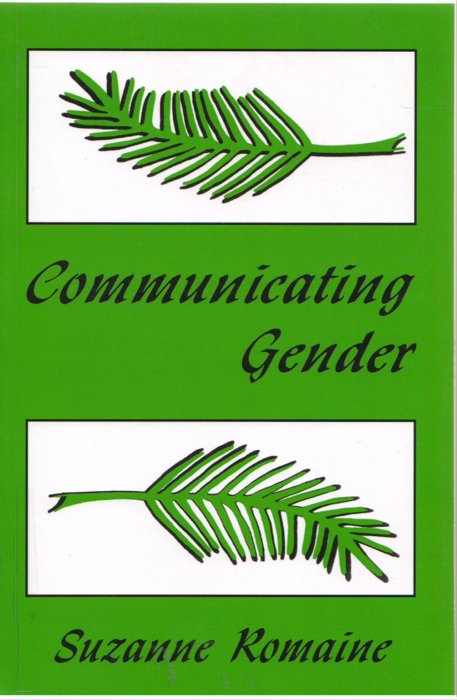
Detailed information
Romaine, Suzanne
Communicating Gender / Suzanne Romaine. - New york; London : Psychology Press, 2012. - 406p. : couv ill.
en coul. ; 24 cm.
Bibliogr. p.357- 382. Index p.383-406
ISBN 978-0-8058-2926-6
ROM/81’27

Slide 13
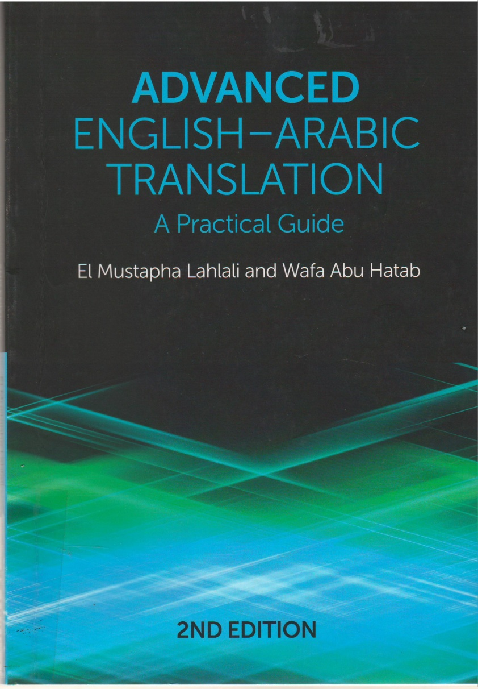
Detailed information
Lahlali, El Mustapha
Advanced english-arabic translation : A practical guide / El Mustapha Lahlali, Wafa Abu Hatab. - London :
Edinburgh University Press, 2022. - xii-261 p. : couv. ill. en coul. ; 25 cm.
Bibliogr. p.259-261
ISBN 978-1-4744-8869-3
Arabe(language); Higher education textbooks
LAH/81’25

Slide 14
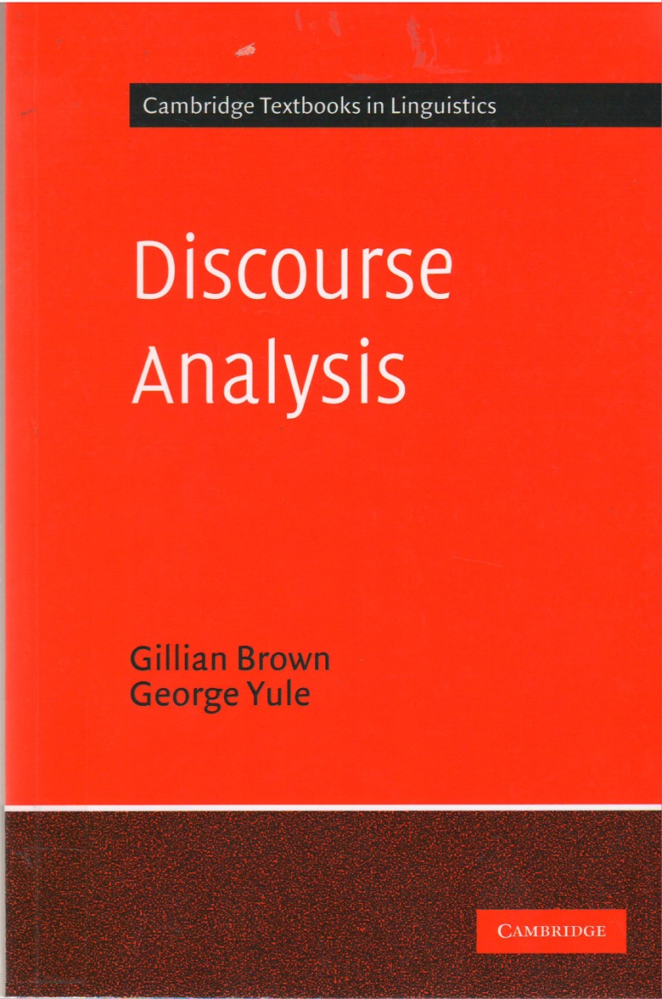
Detailed information
Brown, Gillian
Discourse analysis / Gillian Brown, George Yule. - London; Cambridge : Cambridge University Press, 1983. –XII-288 p. : couv. en coul. ; 23 cm. - ((Cambridge textbooks in linguistics)).
Bibliogr. p. 272-283. Index p. 284-288
ISBN 978-0-521-28475-2 BRO/81’42

Slide 15
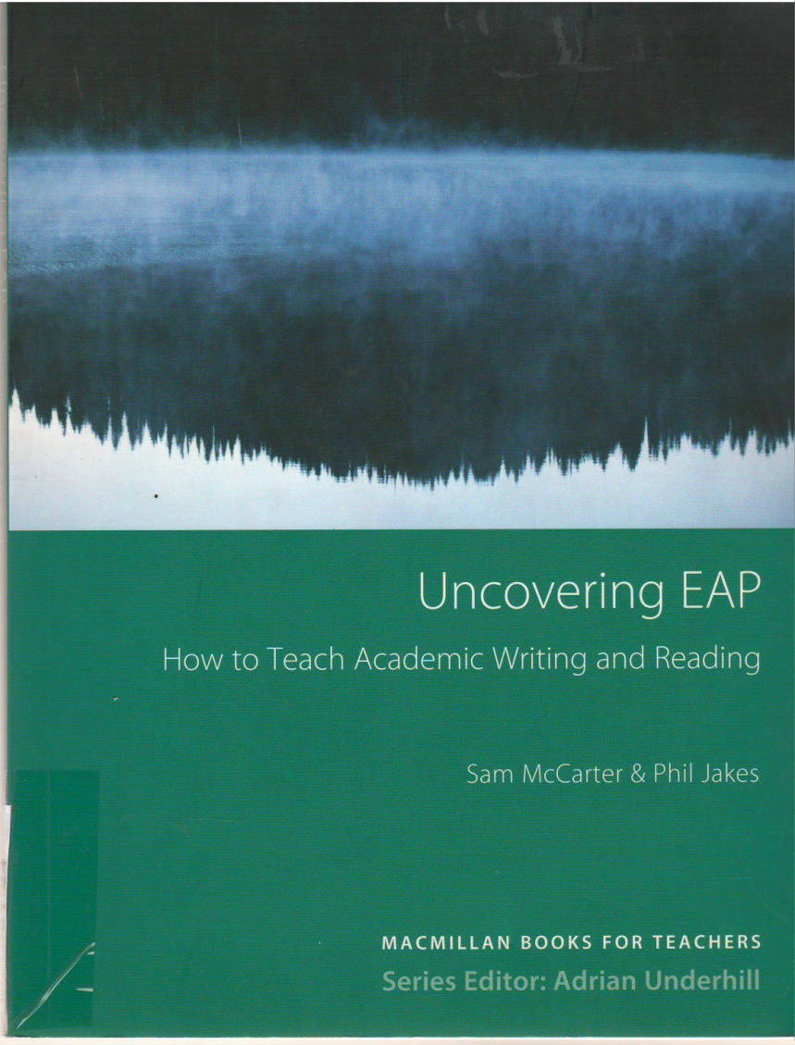
Detailed information
McCarter, Sam
Uncovering EAP : teaching academic writing and reading / Sam McCarter, Phil Jakes. - Oxford : Macmillan
Education, 2009. - 176 p. : ill. ; 25 cm. - ((Macmillan books for teachers)).
Notes bibliogr. et index
ISBN 978-0-230-72322-1
McC/81’24

Slide 16
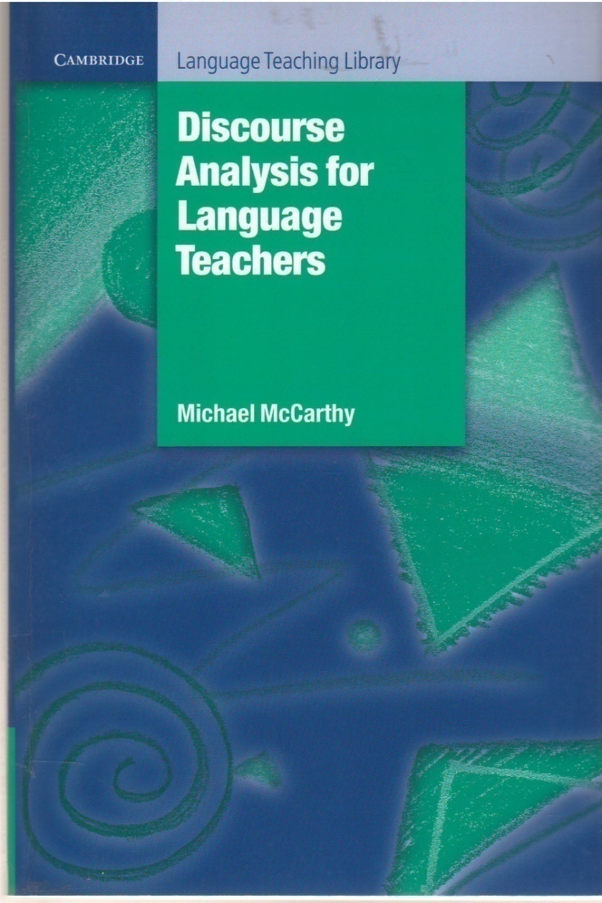
Detailed information
McCarthy, Michael
Discourse analysis for language teachers / Michael McCarthy. - New York; Cambridge : Cambridge University Press, 1991. - x-213 p. : ill. ; 24 cm. - (Cambridge language teaching library).
Bibliogr. p. 193-205. Index
ISBN 978-0-521-36746-2
McC/81’42

Slide 17
Detailed information
Kristeva, Julia
Desire in language : a semiotic approach to literature and art / Julia Kristeva. - New York : Columbia University Press, 1980. - XI-305 p. : ill., couv. ill.. ; 24 cm. - (European perspectives (New York)).
Réf. bibliogr. en fin de chapitres. Index
ISBN 978-0-231-04807-1
KRI/81’22

Slide 18
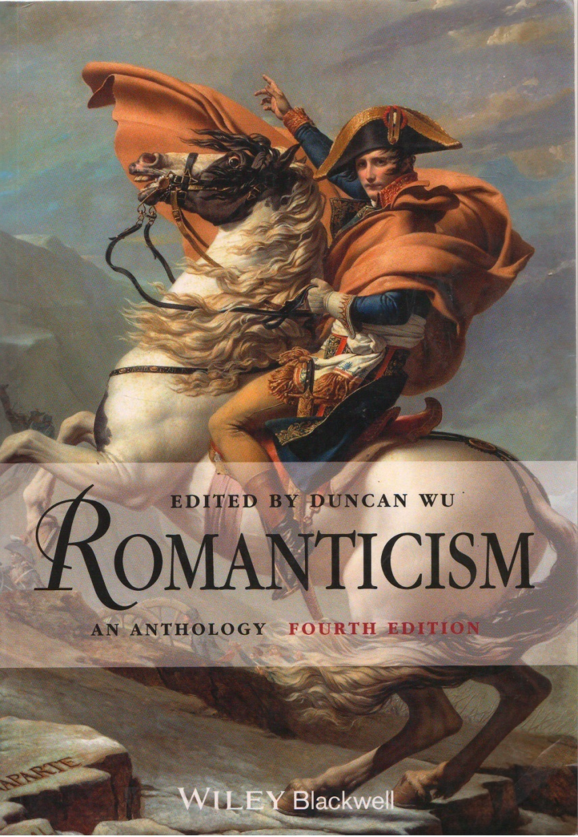
Detailed information
Wu, Duncan
Romanticism : an anthology / Duncan Wu; Ed.04. - Oxford : Blackwell, 2012. - lxxix-1558 p. : ill. en noir et en
coul., couv. ill. en coul. ; 25 cm.
Bibliogr. en fin d'articles. Chronol. Index
ISBN 978-1-4051-9075-6
WU/82

Slide 19
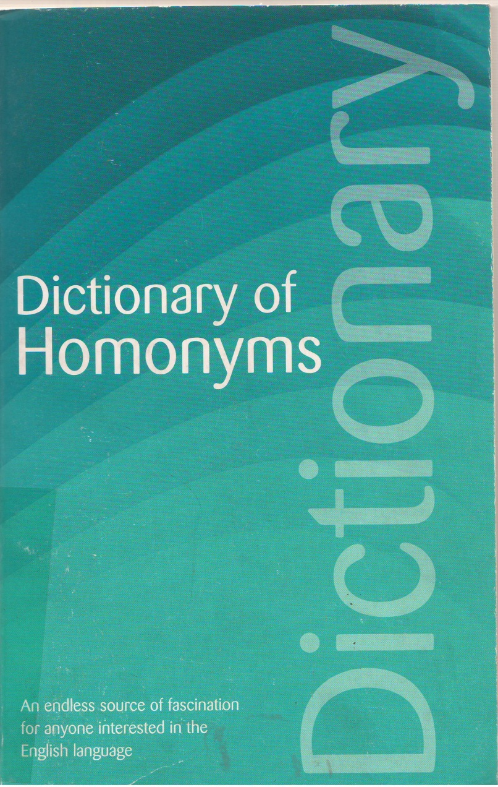
Detailed information
Rothwell, David
Dictionary of Homonyms / David Rothwell. - London : ‎ Wordsworth Editions Limited, 2007. - 544p. ; 22 cm.
Bibliogr. p. 544
ISBN 978-1-84022-542-6
ROT/81’373.423

Slide 20
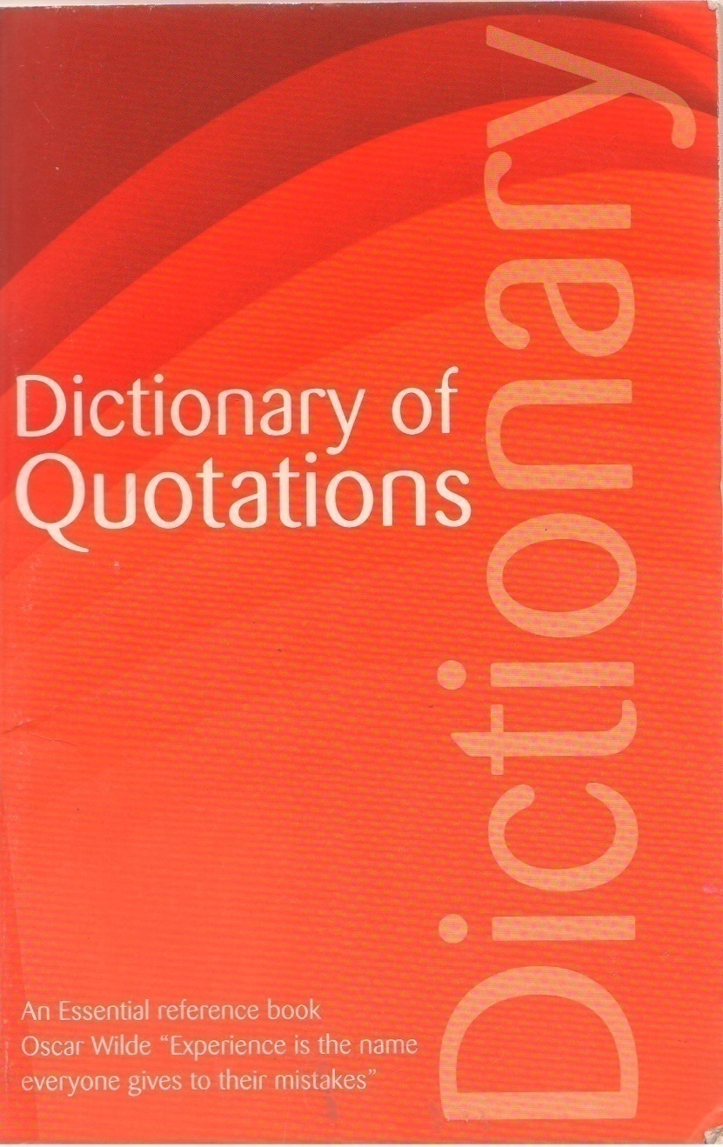
Detailed information
Robertson, Connie
The Wordsworth Dictionary of Quotations / Connie Robertson. - Ed.03. - London : Wordsworth Editions
Limited, 1998. - 669 p. ; 22 cm.
ISBN 978-1-85326-489-4
ROB/81’374

Slide 21
Detailed information
Harmer, Jeremy.
The practice of English language teaching / Jeremy. Harmer. - Ed.02. - London : Pearson Longman Education, 2015. - 446 p. : ill., couv. ill. en coul. ; . - 1 DVD ; 12 cm ; 25 cm. Bibliogr. p. 190-197. Index
ISBN 978-0-521-59646-6
HAR/81’24

Slide 22
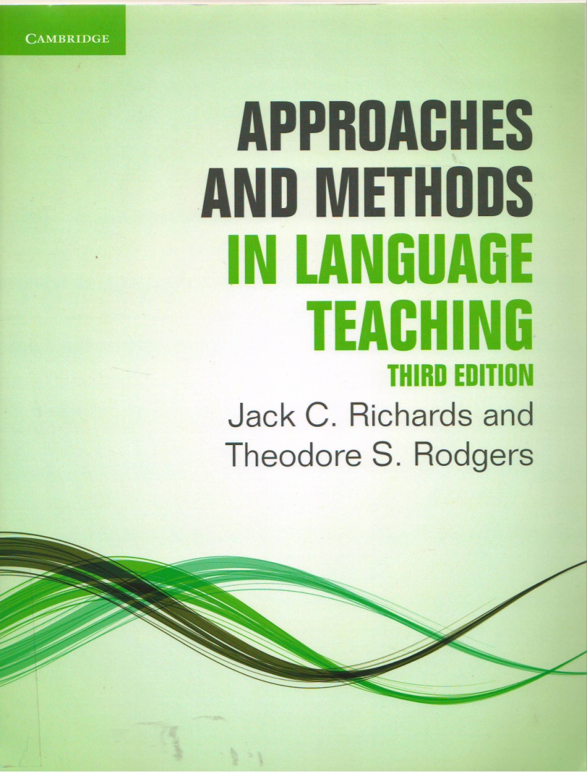
Detailed information
Richards, Jack Croft
Approaches and methods in language teaching / Jack Croft Richards, Theodore Stephen Rodgers. - Ed.03. -Cambridge : Cambridge University Press, 2014. - X-410 p. : couv. ill. ; 25 cm.
Bibliogr. en fin de chapitres. Index
ISBN 978-1-107-67596-4 RIC/81’24

Slide 23
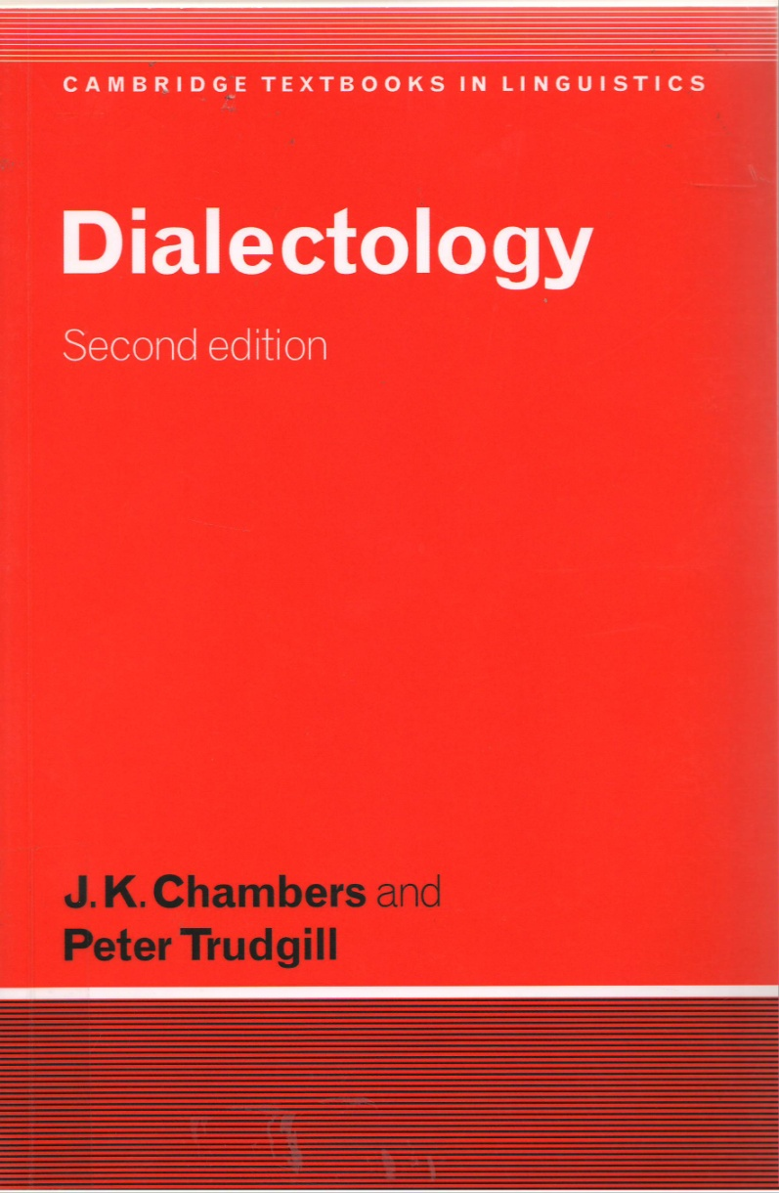
Detailed information
Chambers, J. K .
Dialectology / J. K . Chambers, Peter Trudgill. - Cambridge; New York; Melbourne : Cambridge University
Press, 1998. - xiv-201 p. : ill., cartes, graph. ; 23 cm. - (Cambridge textbooks in linguistics).
Bibliogr. p. 190-197. Index
ISBN 978-0-521-59646-6
CHA/81’28

Slide 24
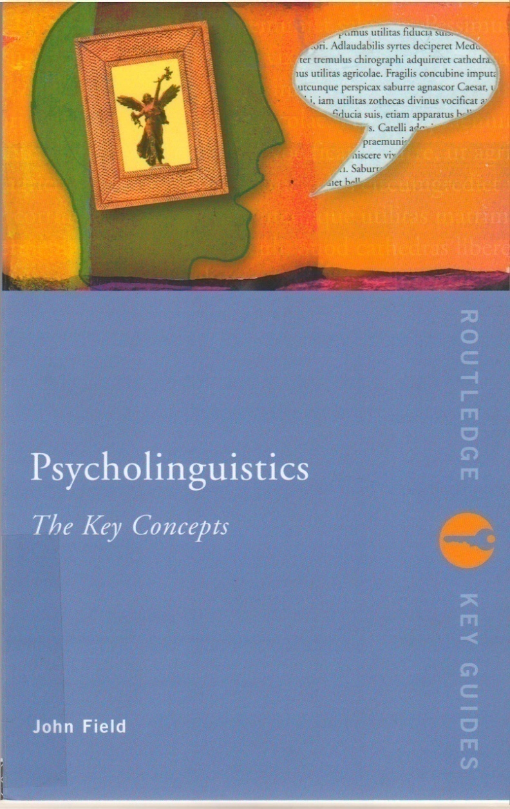
Detailed information
Field, john
Psycholinguistics : the key concepts / john Field. - London; New York : Routledge, 2004. - XX-366 p. : ill. ;22cm. - (Routledge key guides).
Bibliogr. p. 335-349. Index
ISBN 0-415-25890-1
FIE/81’23

Slide 25
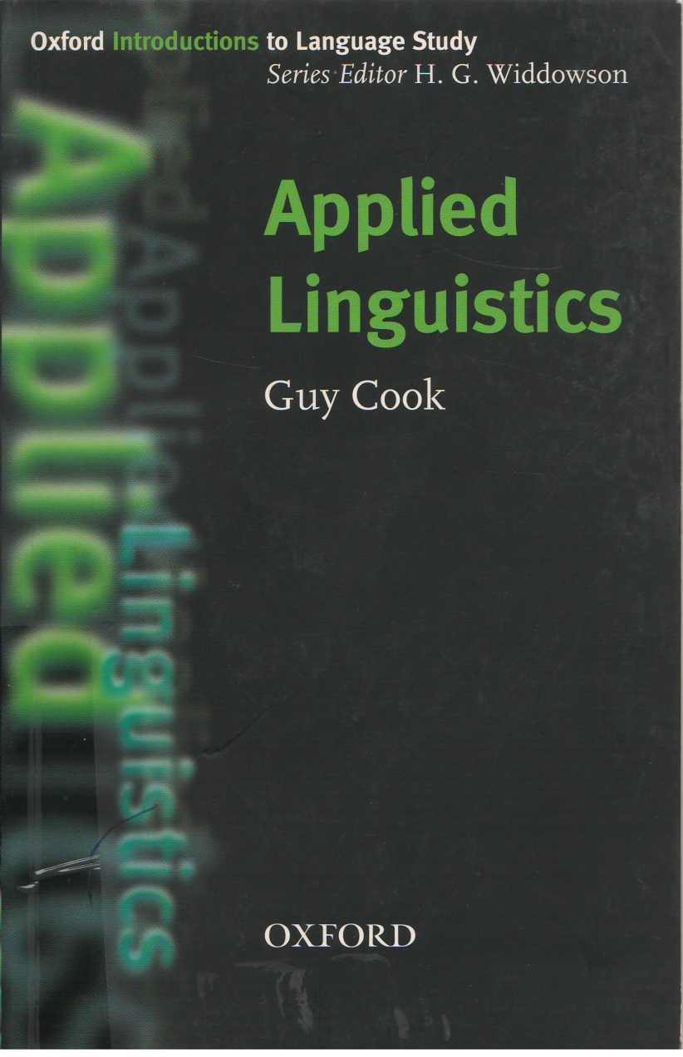
Detailed information
Cook, Guy
Applied linguistics / Guy Cook. - Oxford; New York : Oxford University Press, 2003. - 134 p. : couv. ill. ; 20cm.
- (Oxford introductions to language study).
ISBN 978-0-19-437598-6
COO/81’33

Slide 26
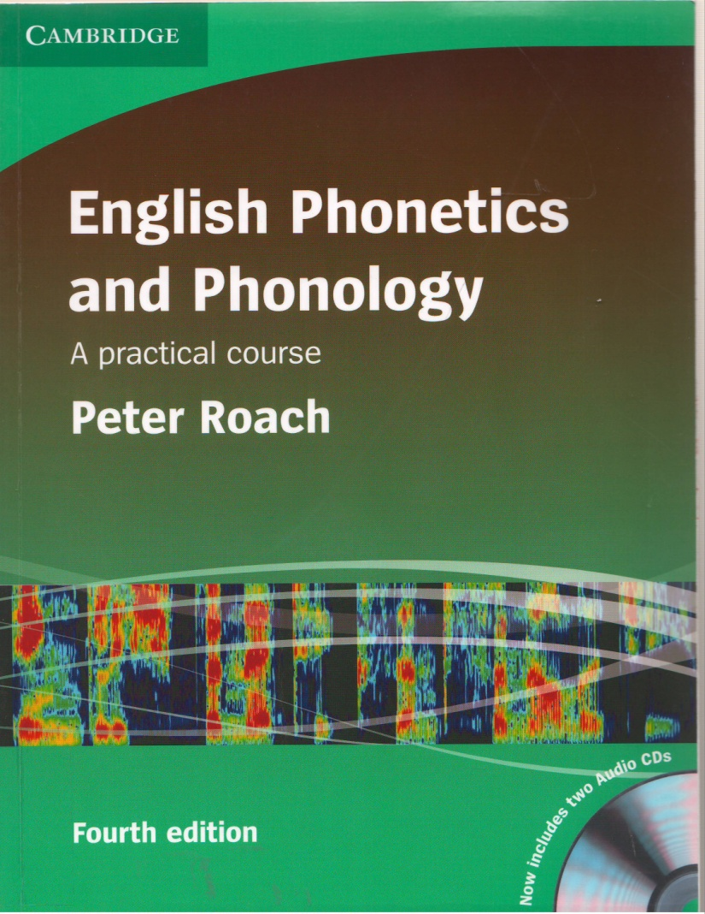
Detailed information
. Roach, Peter
English phonetics and phonology : a practical course / Peter Roach. - Ed. 04. - Cambridge : Cambridge
University Press, 2009. - XII-231 p. : ill., couv. ill. en coul..- 2 disques compacts ; 12 ; 23 cm. - ((Cambridge)).
Bibliogr. p. 222- 226.
ISBN 978-0-521-71740-3
ROA/81’34

Slide 27
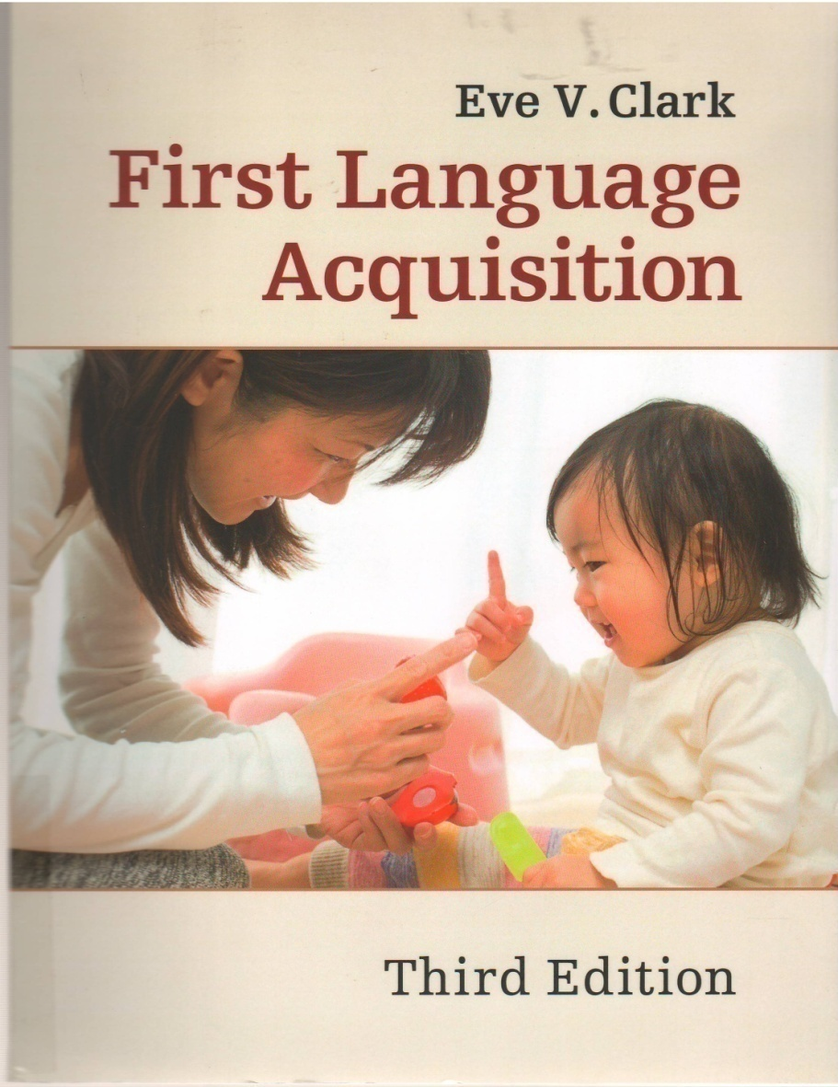
Detailed information
Clark, Eve V.
First language Acquisition / Eve V. Clark. - ed.03. - Cambridge : Cambridge university press, 2016. - XIII-575p. : couv. ill. en coul. ; 24 cm.
Bibliogr. p. 460-543.
ISBN 978-1-316-50760-5
CLA/81’232

Slide 28
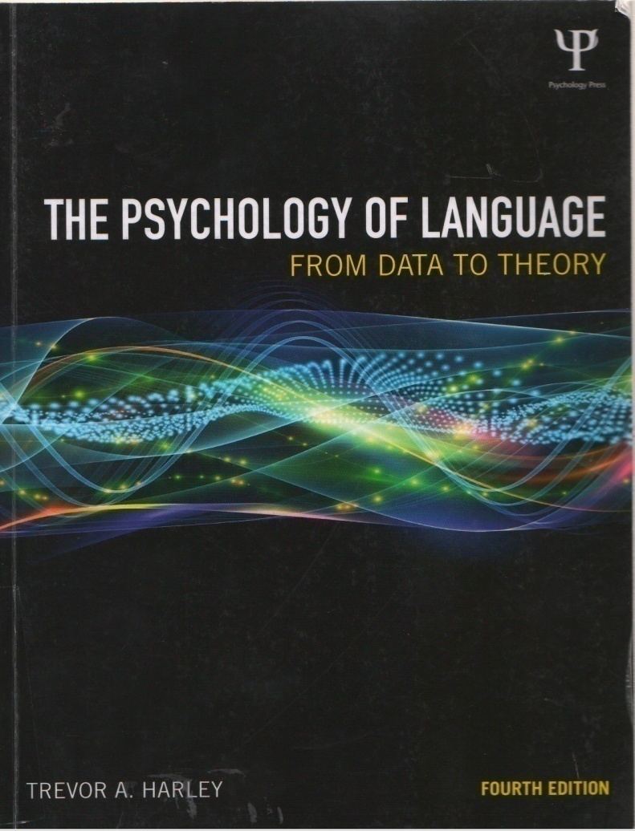
Detailed information
Harley, Trevor A.
The psychology of language : from data to theory / Trevor A. Harley. - Ed. 04. - London, New York :
Psychology Press, 2014. - XV-607 p. : ill. ; 25 cm.
Bibliogr. p. 495 - 568. Index
ISBN 978-1-8487-2089-3
HAR/81’ 23

Slide 29
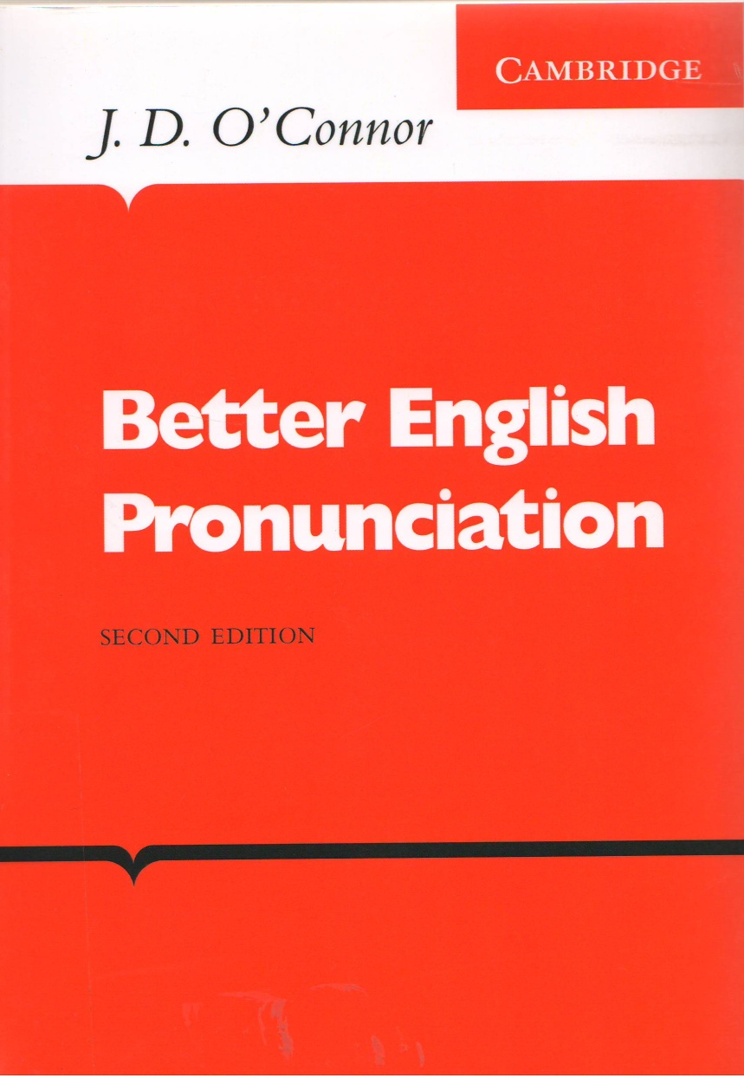
Detailed information
O'Connor, Joseph Desmond
Better English pronunciation / Joseph Desmond O'Connor. - Cambridge : Cambridge University press, 1980.
ISBN 978-0521-23152-7
O'CO/81’355

Slide 30
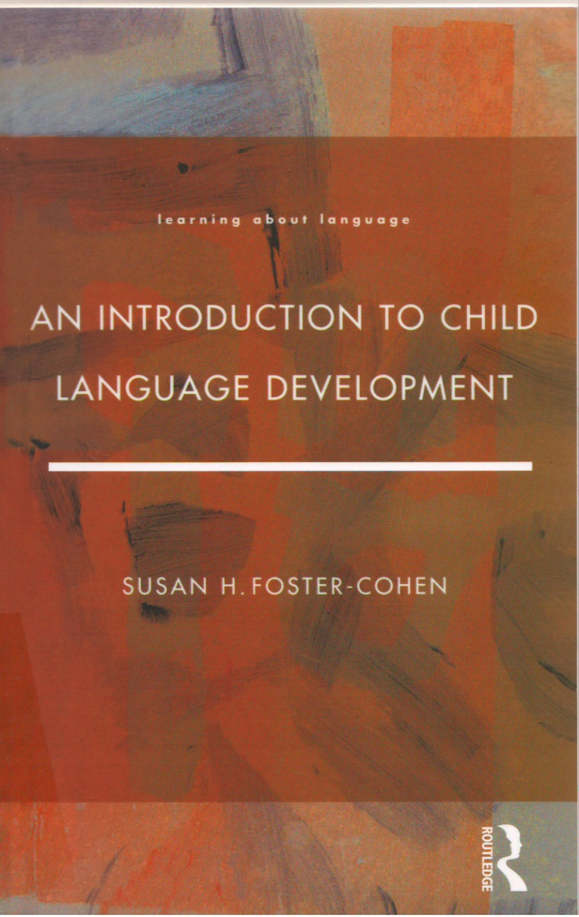
Detailed information
Foster-Cohen, Susan H.
An introduction to child language development / Susan H. Foster-Cohen. - London; New York (N.Y.) :
Longman, 1999. - XV-232 p. : couv. ill. en coul. ; 22 cm. - (Learning about language).
Bibliogr. p. 214-228. Index
SBN 0-582-08729-5
FOS/81’232

Slide 31
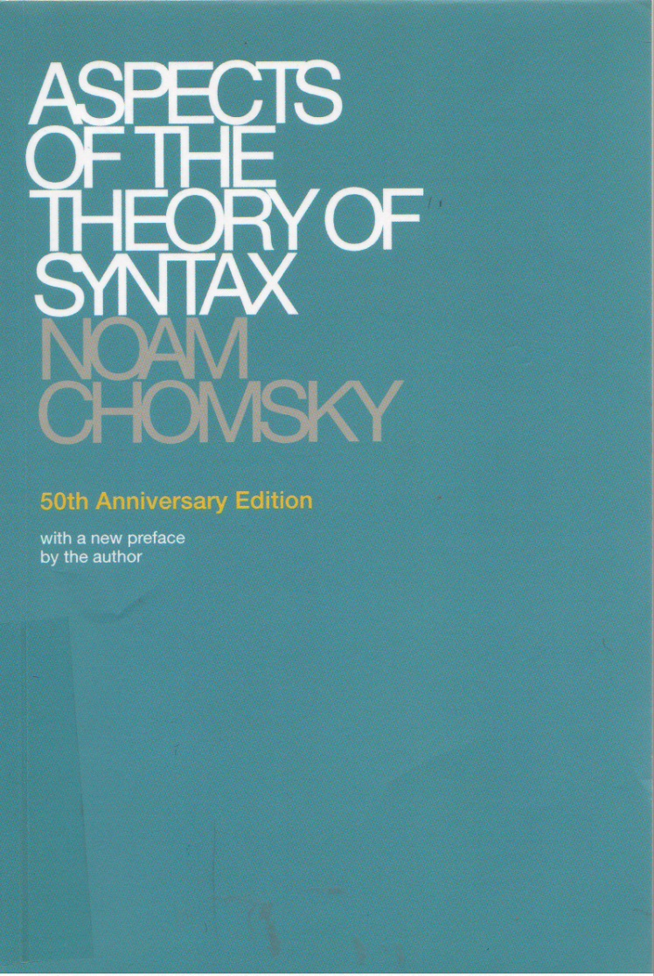
Detailed information
Chomsky, Noam
Aspects of the theory of syntax / Noam Chomsky. - Cambridge; London : The MIT press, 2015. - XXIII-270 p.
; 21 cm.
Bibliographie p. 253 - 263. Index
ISBN 978-0-262-52740-8
CHO/81’367

Slide 32
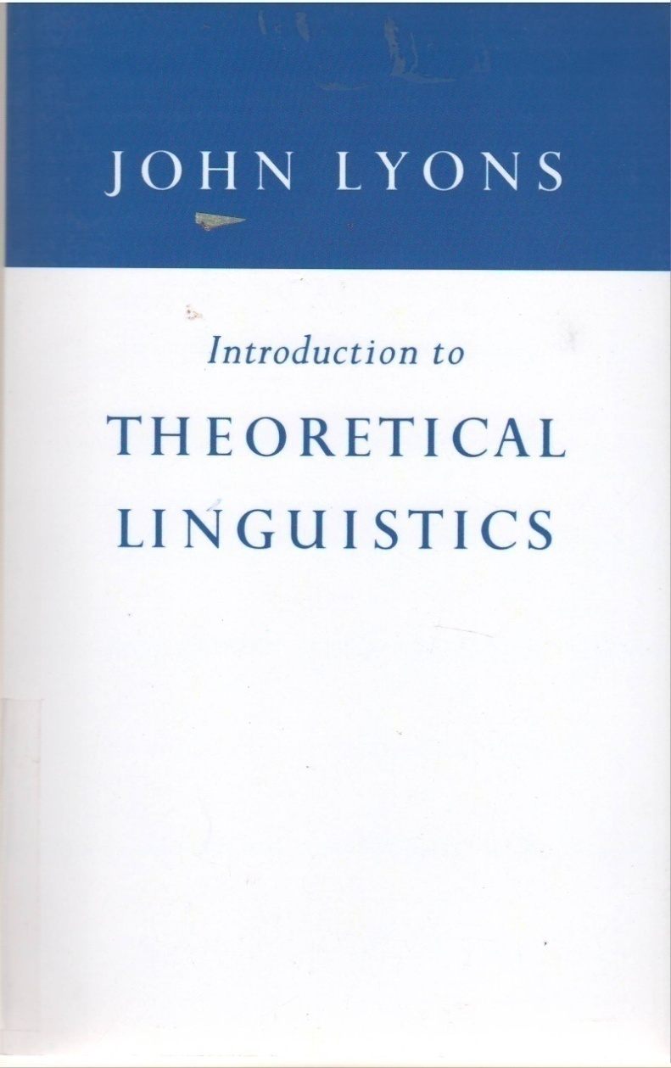
Detailed information
Lyons, Johns
Introduction to Theoretical Linguistics / Johns Lyons. - New York; Cambridge : Cambridge University Press,
1968. - X-519 p. : ill. ; 23 cm.
Bibliogr. p. 490-505. Notes bibliogr. Index
ISBN 0-521-09510-7
LYO/81’16

Slide 33
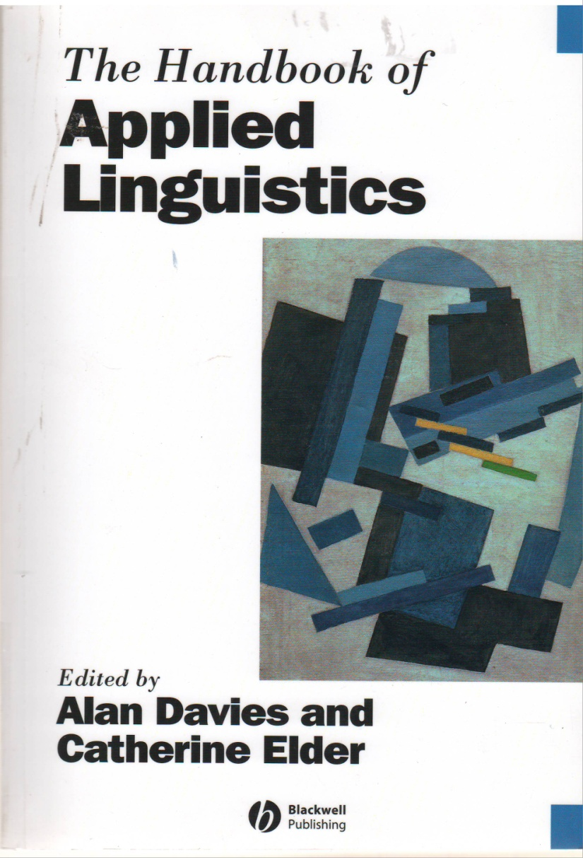
Detailed information
Davies, Alan
The handbook of applied linguistics / Alan Davies, Catherine Elder. - Washington : Blackwell, 2004. –XVII-866 p. : ill., jaquette ill. ; 26 cm. - (Blackwell handbooks in linguistics; 17).
Bibliogr. en fin de chapitres. Index
ISBN 978-1-4051-3809-3
Applied linguistics
DAV/81’33

Slide 34
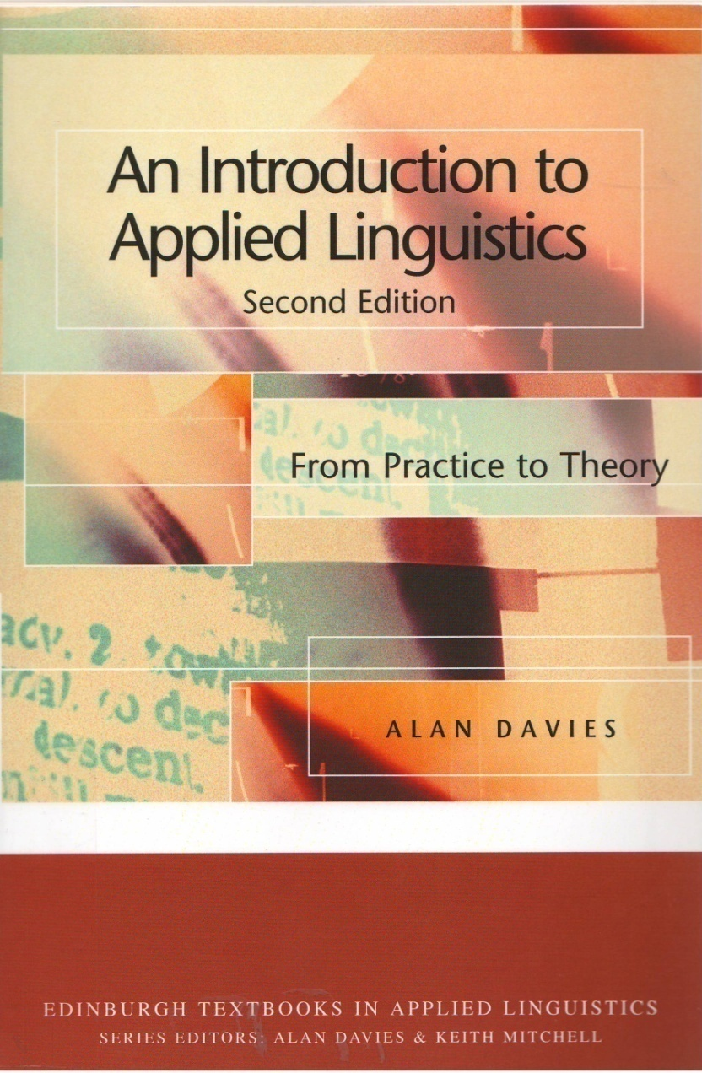
Detailed information
Davies, Alan J.
An introduction to applied linguistics : from practice to theory / Alan J. Davies. - Ed.02. - London : Edinburgh
university press, 2007. - XI-199 p. : couv. ill. en coul. ; 24 cm. - (Edinburgh textbooks in applied linguistics).
Bibliogr. p. 180 -193.
ISBN 978-0-7486-3355-5
DAV/81’33

Slide 35
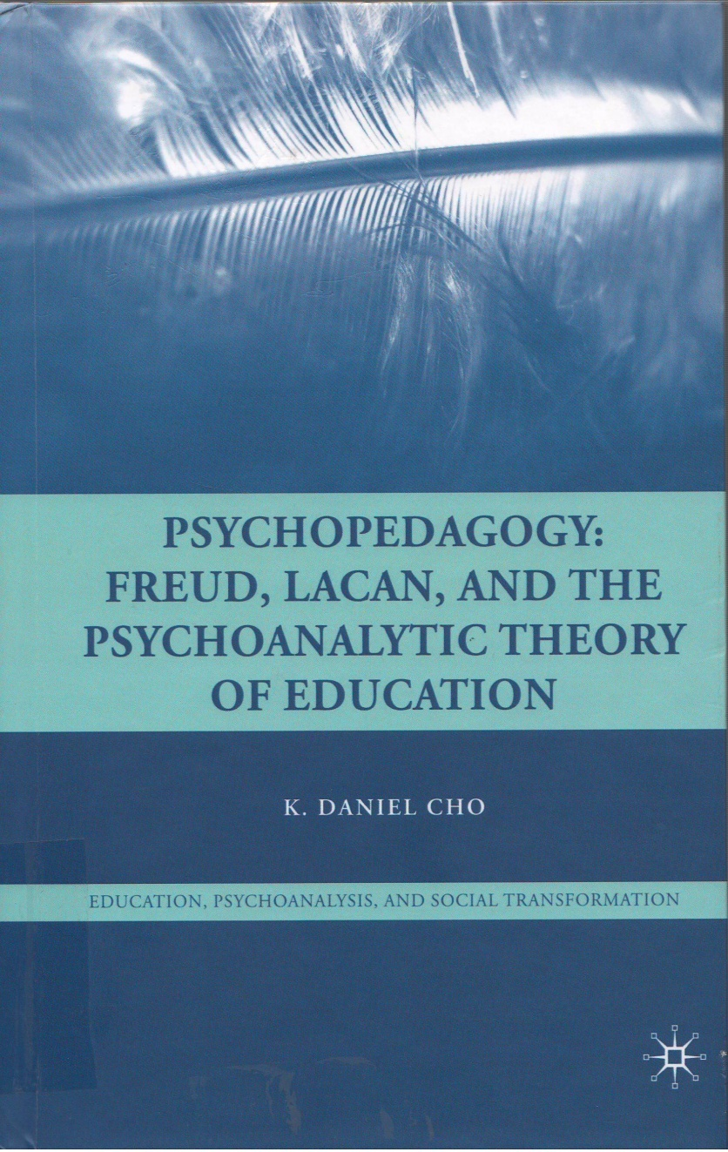
Detailed information
CHO, Daniel
Psychopedagogy : FREUD, LOCAN and the Psychoanalytic Theory of Education / Daniel CHO. - United States : PALGRAVE MACMILLAN, 2009 191p. ; 23 cm. - ISBN 978-0-230-60608-1
CHO/81’23

Slide 36
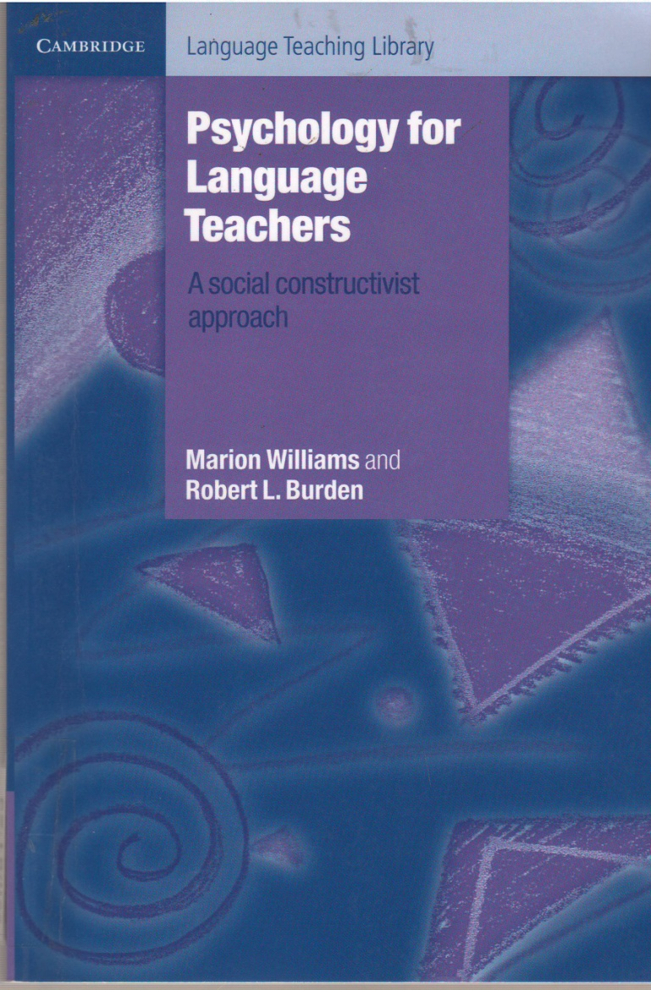
Detailed information
Williams, Marion
Psychology for language teachers : a social constructivist approach / Marion Williams, Robert L. Burden. –Cambridge : Cambridge university press, 1997. - IX-240 p. : couv. ill. en coul. ; 23 cm. - (Cambridge language
teaching library).
Bibliogr. p. 209-227. Index
ISBN 978-0-521-49880-7
WIL/81’23

Slide 37
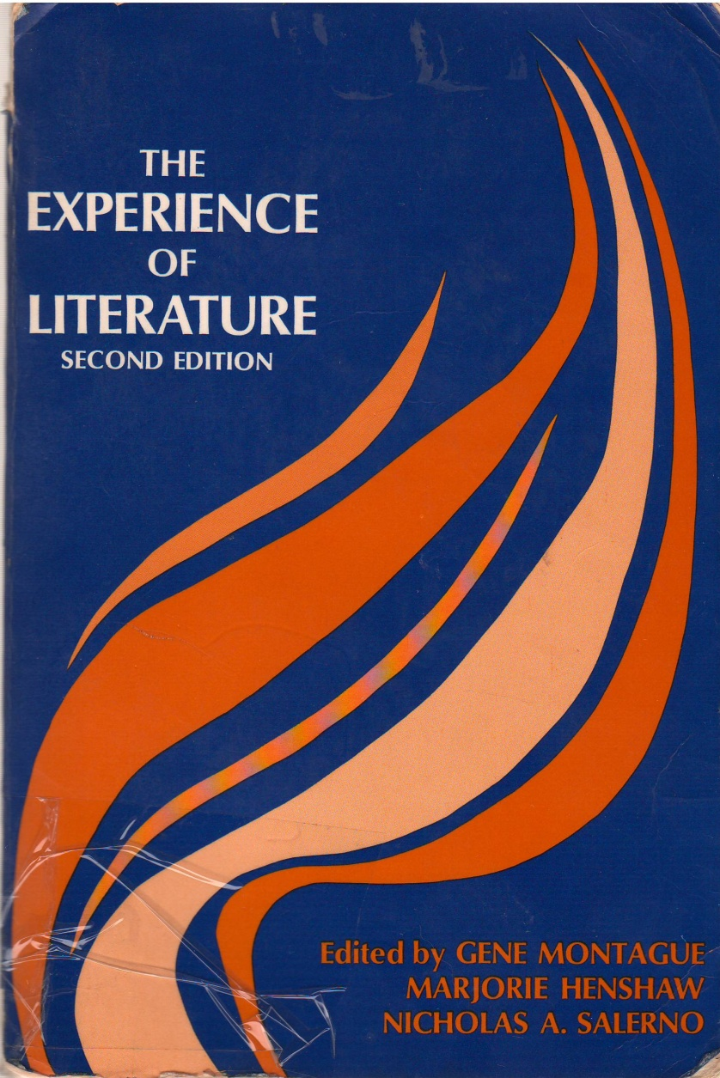
Detailed information
Montague, Gene
The experience of Literature/ Gene Montague. - United States : Prentice Hall, 1970
- 801p.; 21 cm.
ISBN 13-294728-5
MON/82-82'2

Slide 38
Detailed information
Abderrahmane, ARAB
Politics and the novel in AFRICA / Gene Montague. - ALGERIE : O.P.U., 1982
- 406p.; 24c.m.
ARA/82-31.09

